Slide 1

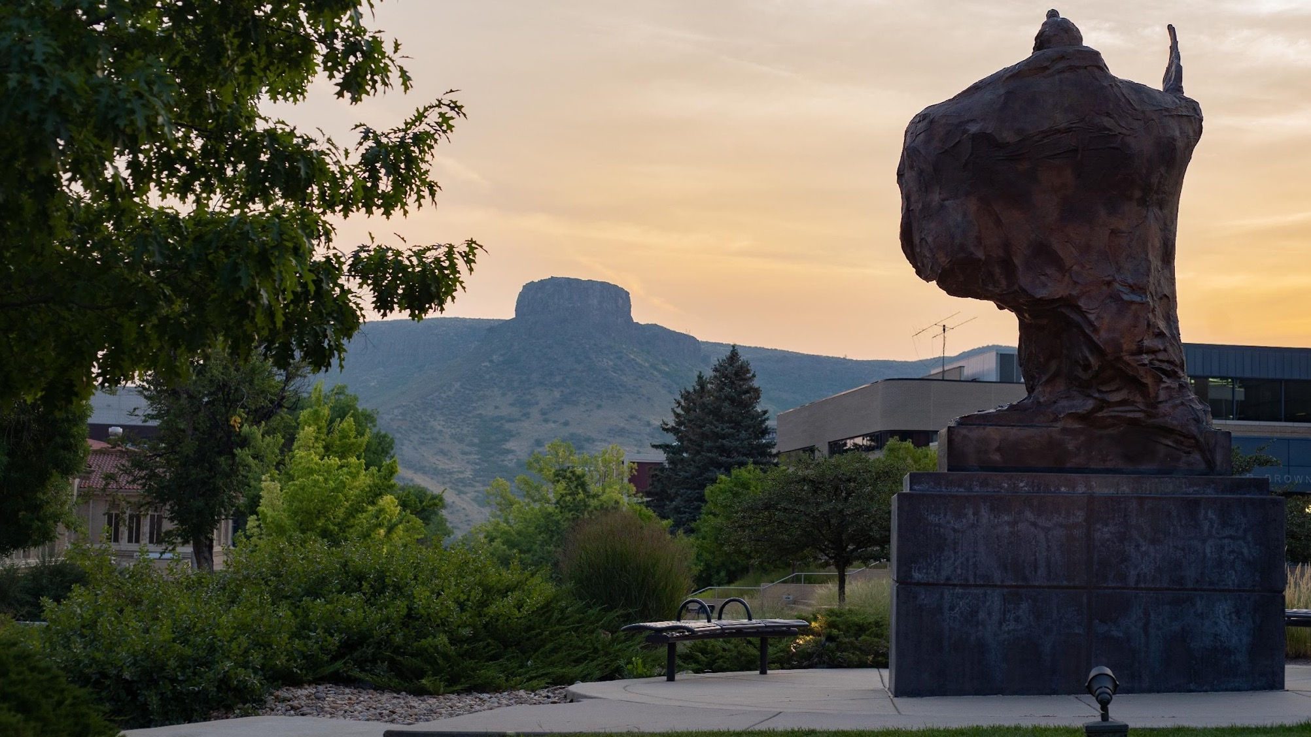
WiFi simulation over House Domain
MATH550: Numerical Solution for PDE Fall-2023
Eric Gelphman and Ahmed Ahmed
1

Slide 2
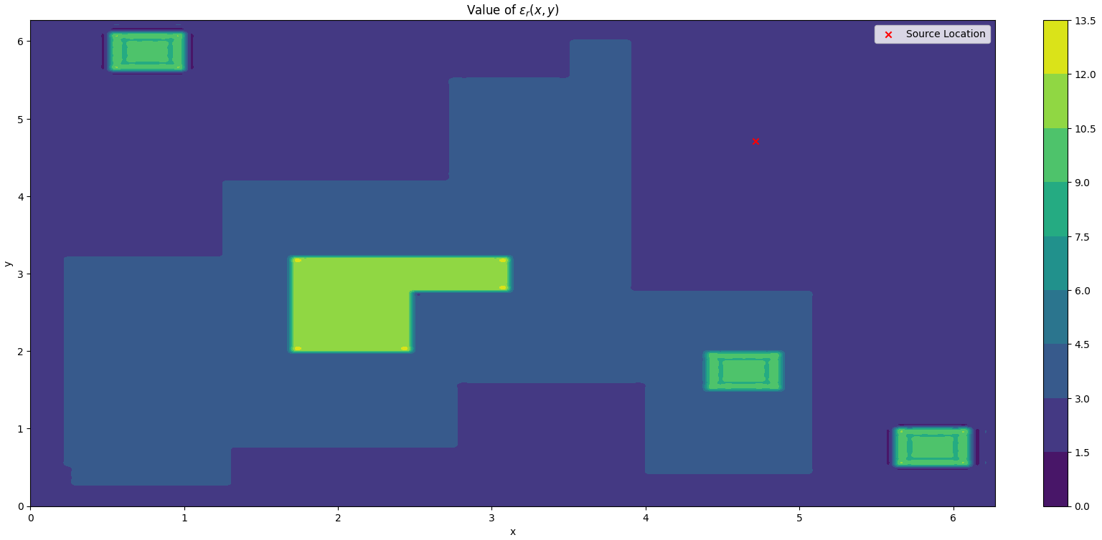
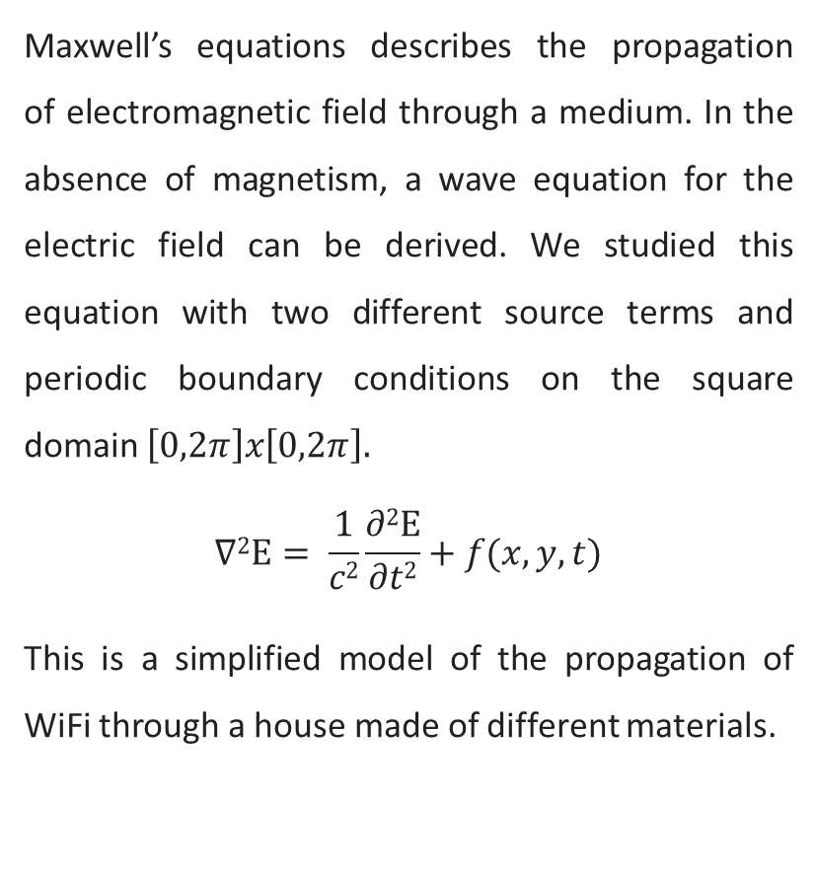
Wave Equation For Electric Field With Source
Maxwell’s equations describes the propagation of electromagnetic field through a medium. In the absence of magnetism, a wave equation for the electric field can be derived. We studied this equation with two different source terms and periodic boundary conditions on the square domain $\left[0,2π\right]x\left[0,2π\right].$
$$∇2Ε= \frac{1}{c2}\frac{∂2Ε}{∂t2}+f(x,y,t)$$
This is a simplified model of the propagation of WiFi through a house made of different materials.
2

Slide 3
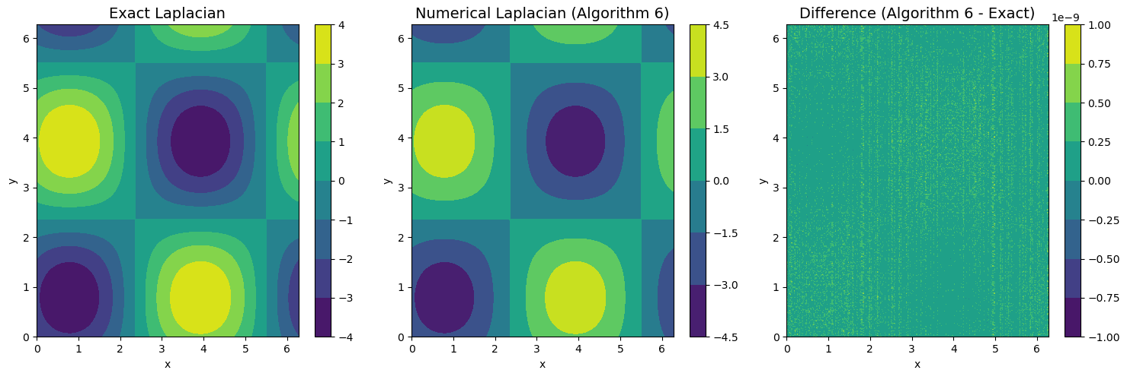
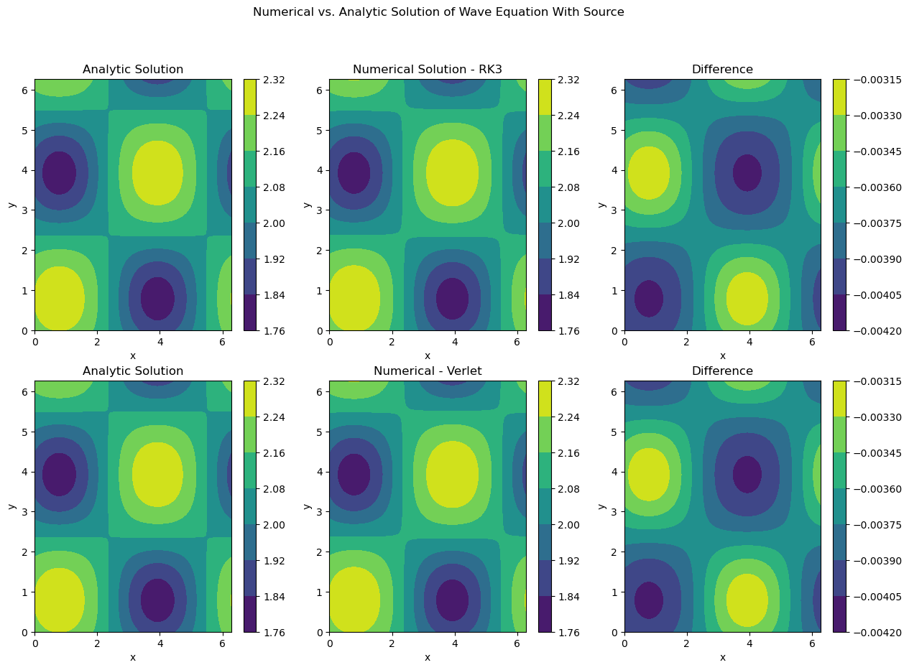
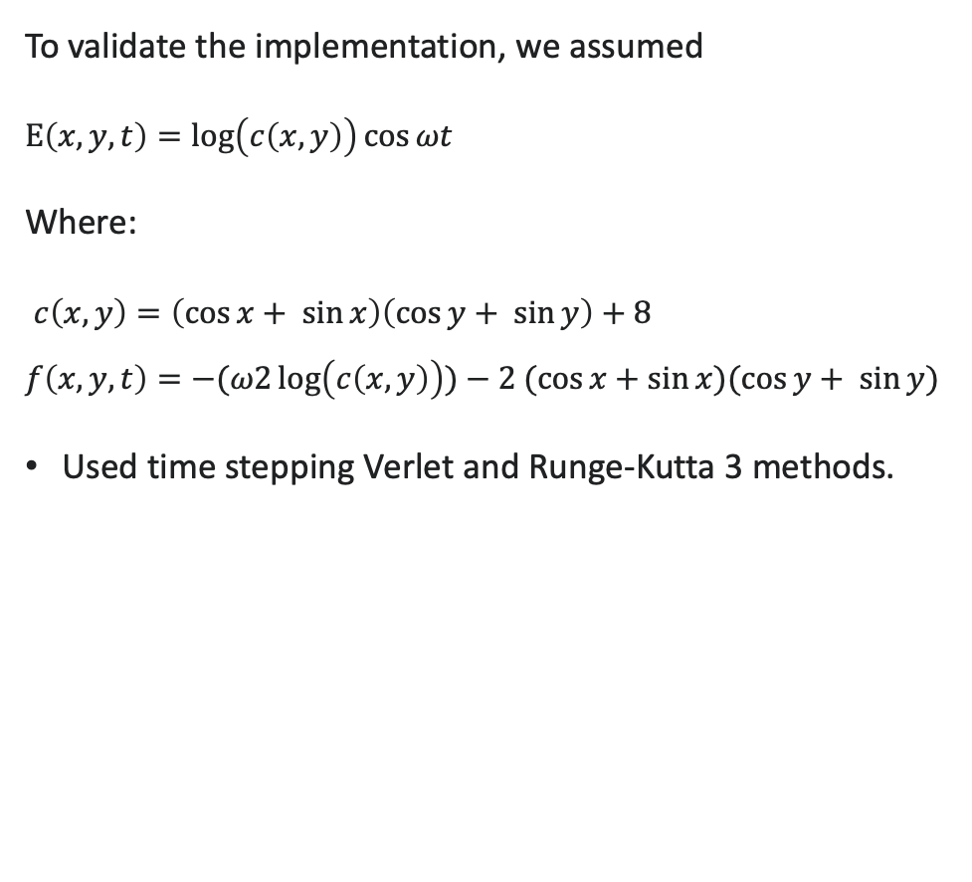
Manufactured Solution
To validate the implementation, we assumed
$Ε\left(x,y,t\right)=\log\left(c\left(x,y\right)\right)\cos{ωt}$
Where:
$c\left(x,y\right)=\left(\cos{x}+ \sin{x}\right)\left(\cos{y+ \sin{y}}\right)+8$
$$f\left(x,y,t\right)=−(ω2\log\left(c\left(x,y\right)\right))−2 (\cos{x}+\sin{x})(\cos{y}+ \sin{y})$$
Used time stepping Verlet and Runge-Kutta 3 methods.
3

Slide 4
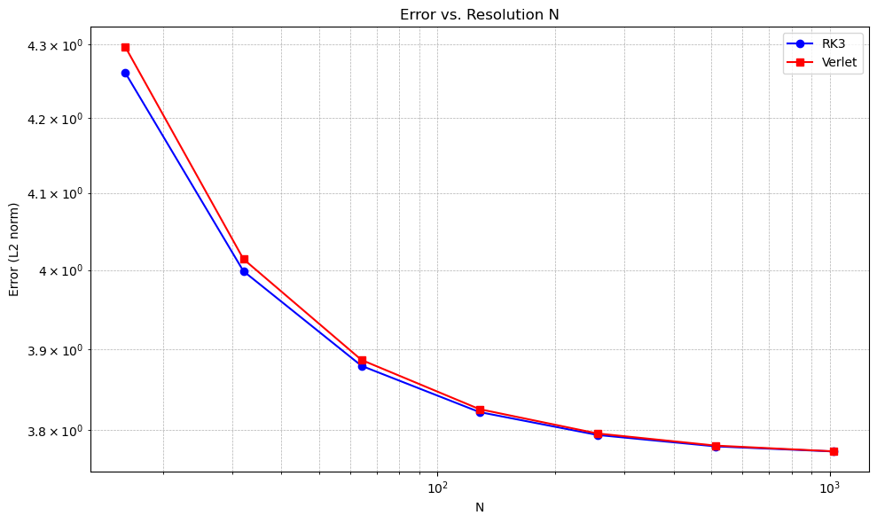
Error Analysis
l2 norm of the difference between the analytical and numerical solutions. It was preformed several testes for the number of grid points (it affects the calculated dt and then the number of steps), N = [16, 32, 64, 128, 256, 512, 1024]. The results indicate that with larger time steps, both methods converge in resolution
4

Slide 5
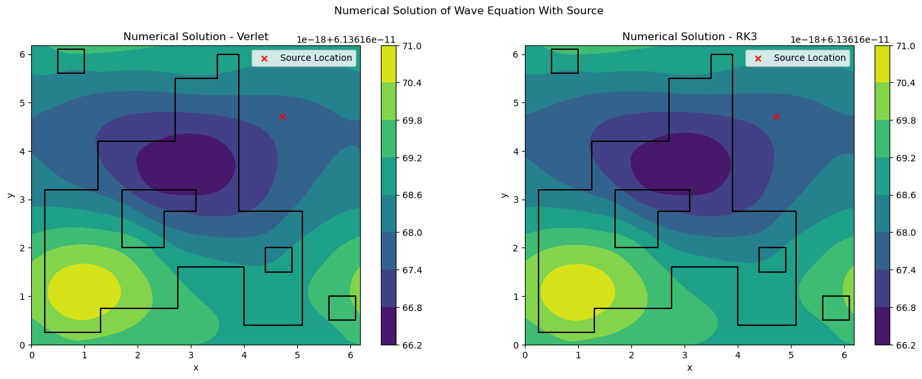
Simulation Using Gaussian – Sinusoidal Source
5

Slide 6
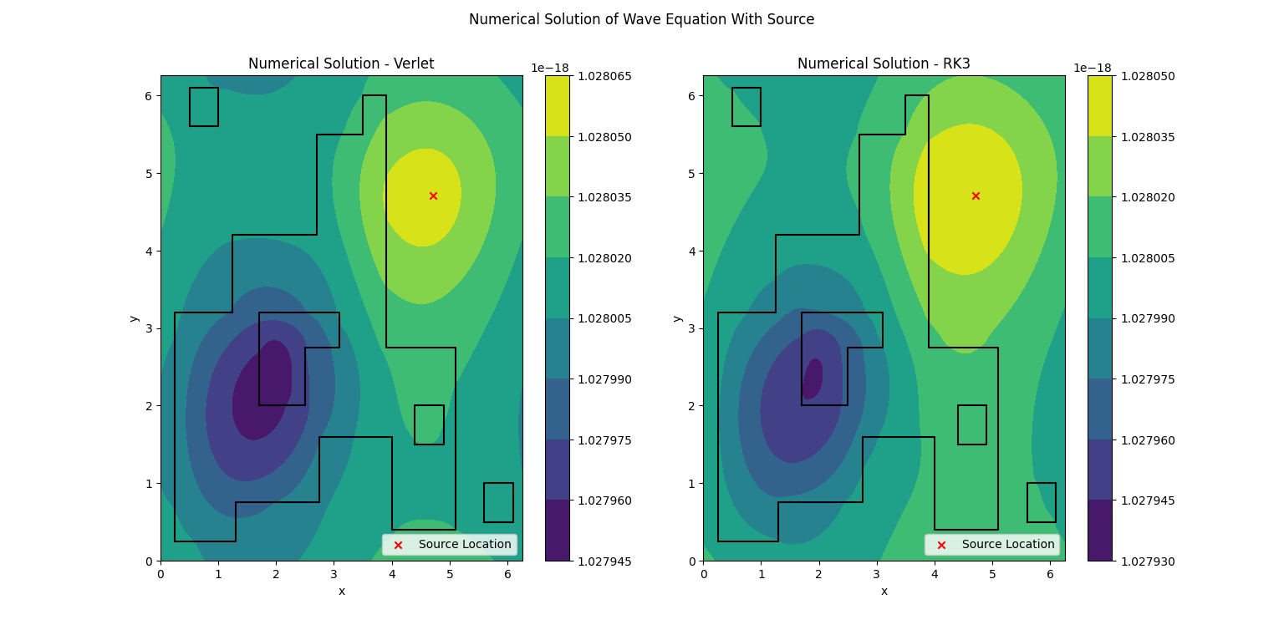
Simulation Using Gaussian – Gaussian Source
6

Slide 7
Future work
Implementation of a more realistic boundary conditions such as radiation (Robin) BCs or most ideally perfectly matched layer(PML)
Implementation of more realistic source functions modeled after real WiFi antennas
7

